Slide 1

ECE 419/619 Electric Machines and Drives
Reference Frame Theory

Slide 2
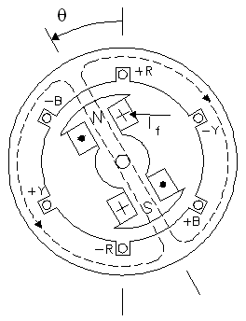
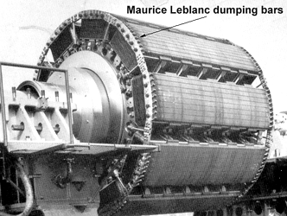
Reference Frame Theory (Chapter 3)
Introduced by R.H. Park in 1929 to model synchronous machines

Slide 3
Three-Phase Transformation to the Arbitrary Reference Frame
f = voltage, current, or flux linkage
q = q-axis (quadrature axis)
d = d-axis (direct axis)
0 = zero sequence
a = a-phase
b = b-phase
c = c-phase

Slide 4
The Reference Frame Transformation
= reference frame speed (rad/sec)
= reference frame position (rad)

Slide 5
The Inverse Transformation

Slide 6
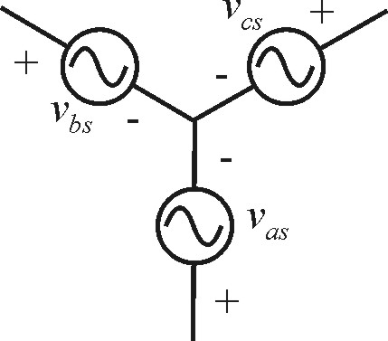
Example: Three-Phase Set of Voltages
electric frequency (Hz)
electric radian frequency (rad/sec)
electrical position (rad)
rms Voltage (V)
phase shift (rad)

Slide 7
Transform to the Arbitrary Reference Frame

Slide 8
Voltages in Arbitrary Reference Frame
q-axis voltage
using the identity,
d-axis voltage
using the identity,
zero sequence voltage

Slide 9
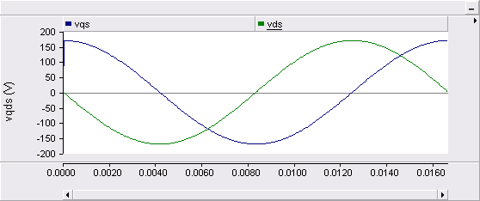
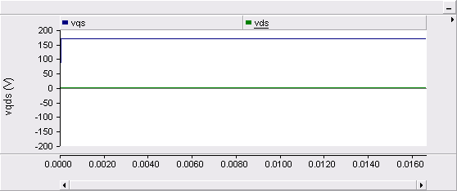
Numerical Example
208 V, 3-phase, f = 60 Hz (208 V line-to-line rms)
1. Stationary reference frame
2. Synchronous reference frame

Slide 10
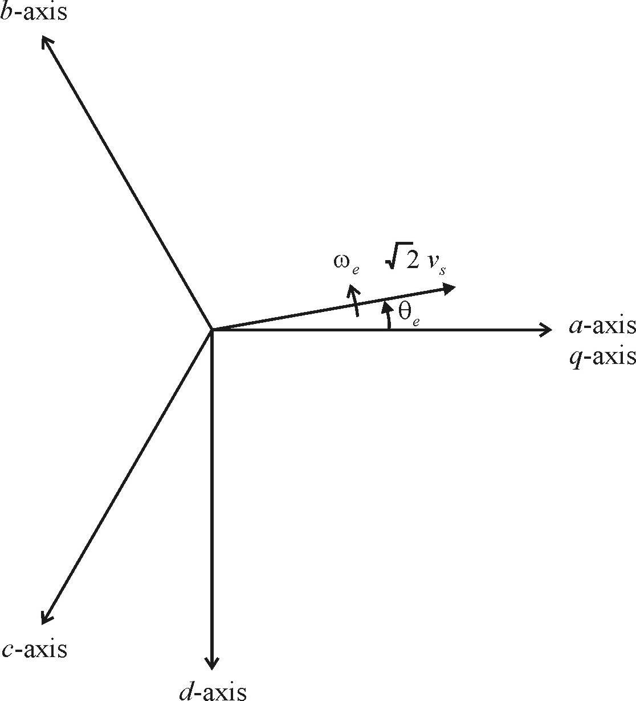

Axis Sketch with θ=0

Slide 11
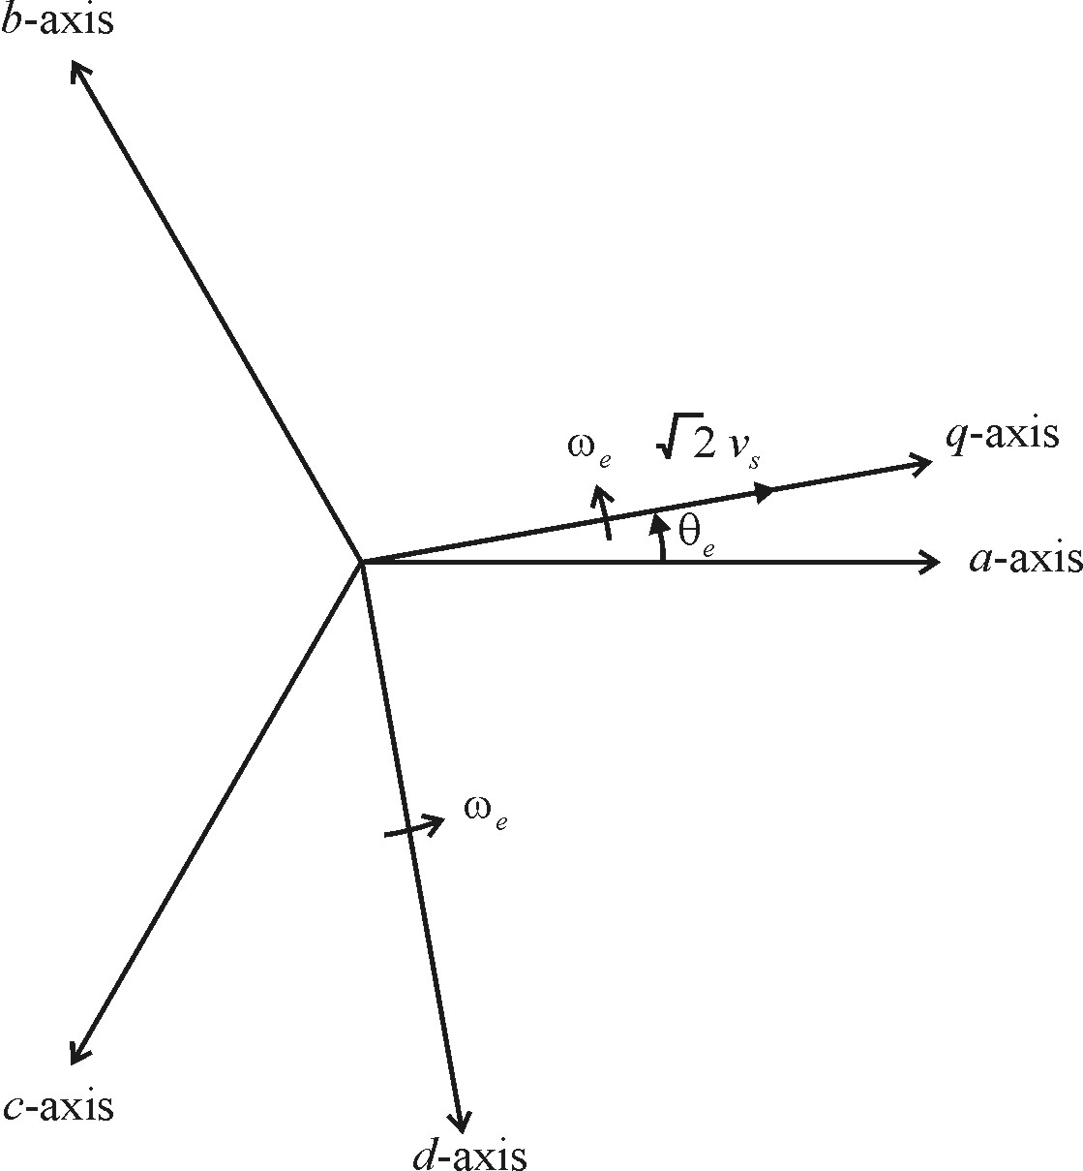

Axis Sketch with θ=θ_{e}

Slide 12
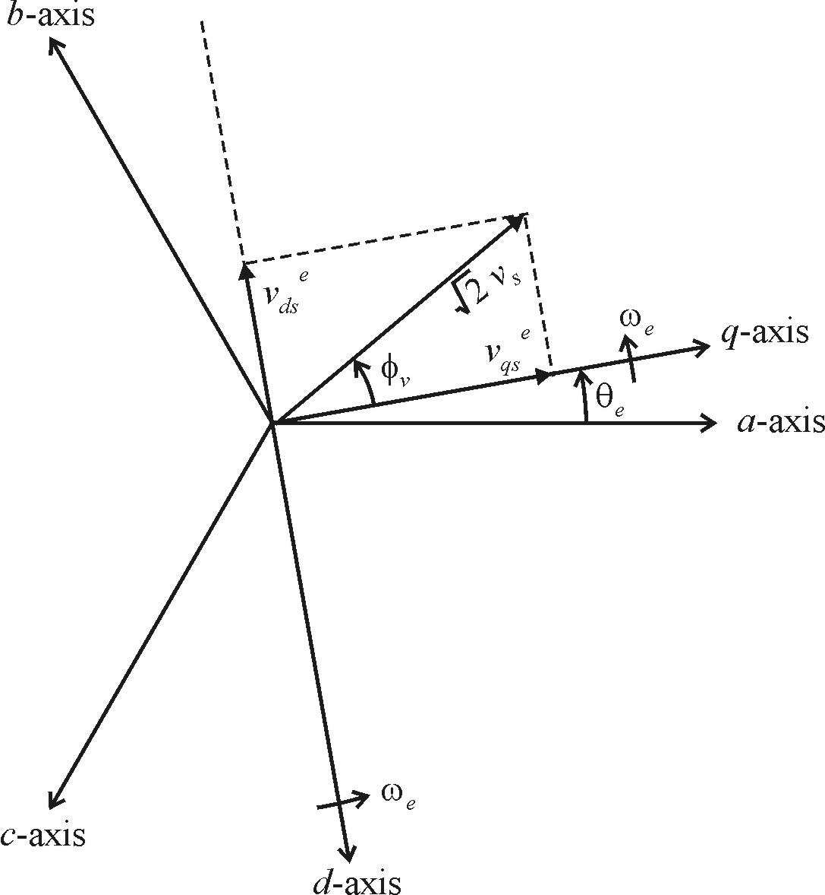
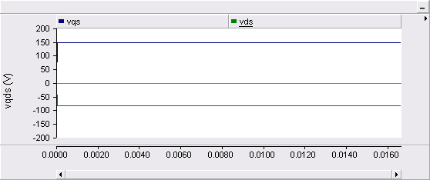
Axis Sketch with θ=θ_{e} and φ_{v}=30º

Slide 13
Commonly Used Reference Frames
Arbitrary
Stationary
Synchronous
Rotor
compact notation
Notes:
In all reference frames
The reference frame speed defines one reference frame. There are an infinite number since θ (0) can be set to any value.

Slide 14
Frame-to-Frame Transformation
define

Slide 15
Real Power in the q-d Reference Frame

Slide 16
Reference Frame Transformation
Developed by R.H. Park in 1929 for analysis of synchronous machines.
Allows treatment of balanced three-phase ac systems as two-phase dc systems.
This leads to application of classical control theory
Also simplifies control equations of some systems

Slide 17
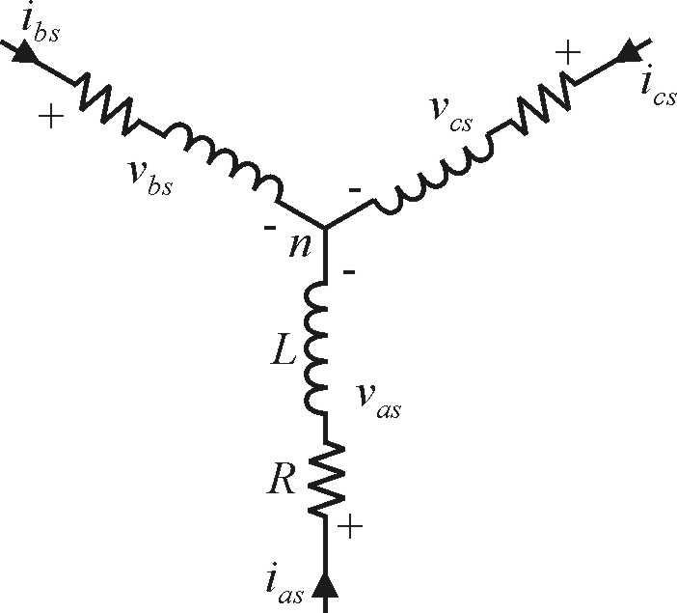
Transforming Circuit Elements: R-L Example
voltage equations
note:
flux linkage equations

Slide 18
Transform Flux Linkage Equations
1. Compress equations
2. Transform equations
3. Expand equations

Slide 19
Transform Voltage Equations
1. Compress equations
2. Transform equations

Slide 20
3. Expand equations

Slide 21
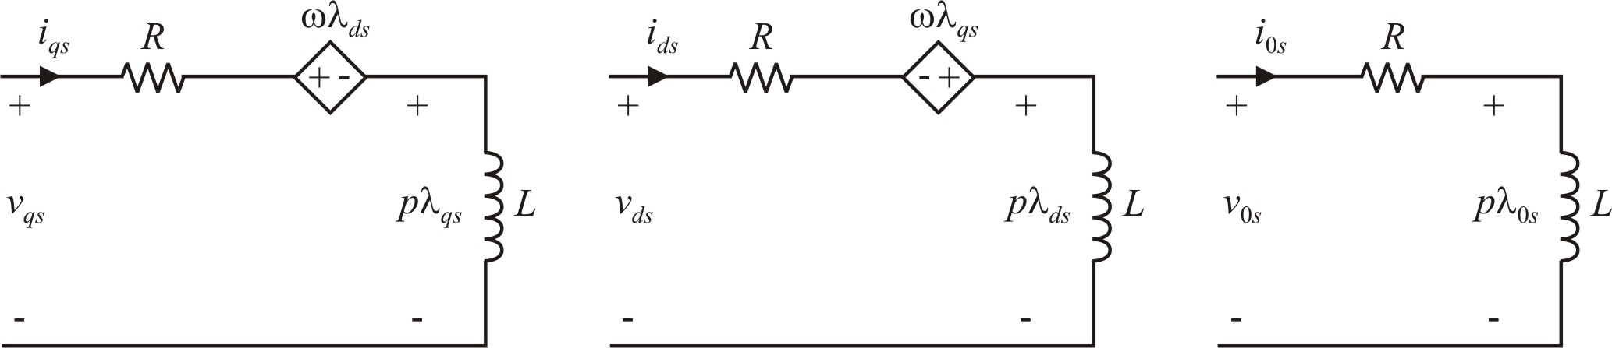
Equivalent Circuit
q-axis
d-axis
zero sequence

Slide 22
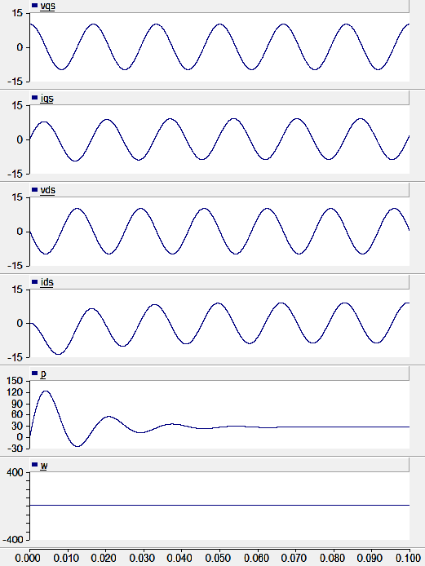
R-L Example from Book Stationary Reference Frame
matches Figure 3.10-1

Slide 23
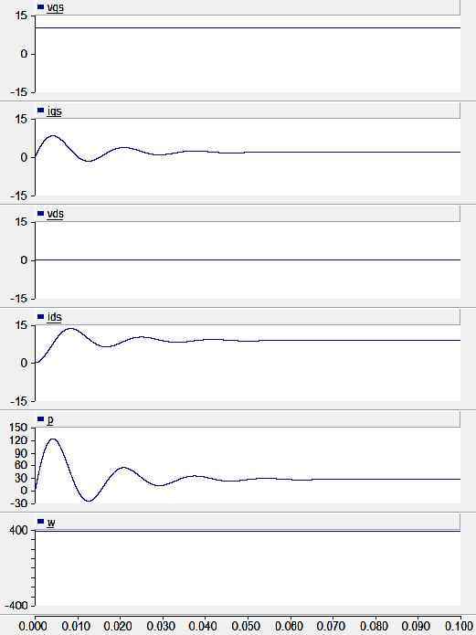
R-L Example from Book Synchronous Reference Frame
matches Figure 3.10-2

Slide 24
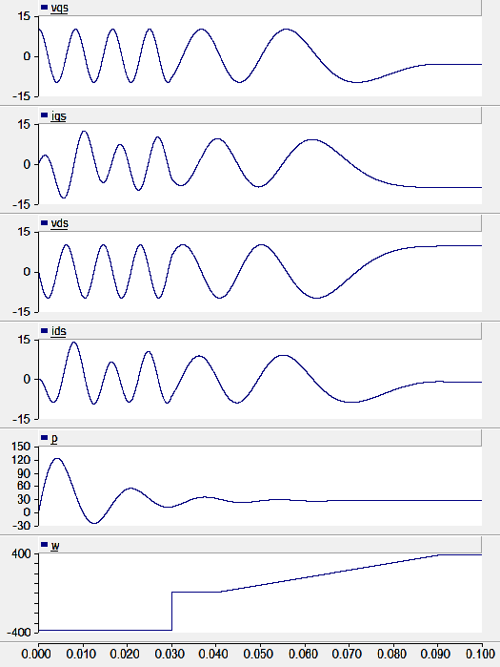
R-L Example from Book Varying Reference Frame
matches Figure 3.10-3

Slide 25
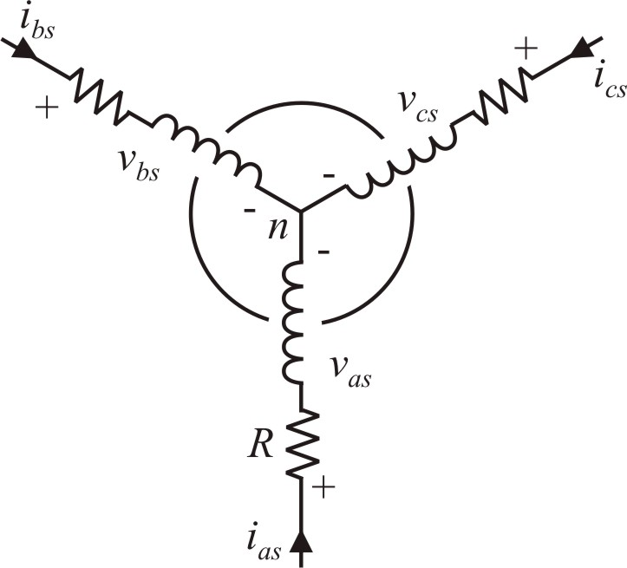
Coupled Inductors
voltage equations

Slide 26
Coupled Inductors
flux linkage equations

Slide 27
expanded form

Slide 28
Transformation of Circuit Elements
Balanced three-phase ac circuits transformed to two-phase dc circuits (neglecting the zero sequence and assuming analysis in the synchronous reference frame)
Flux linkage equations for inductive circuits were used for generality to other circuits; including electric machines
Coupling terms between the q- and d-axes result from the transformation. These will later be viewed as back-emf terms when observing electric machinery in the synchronous reference frame.

Slide 29
Balanced Steady-State Calculations
define

Slide 30
Balanced Steady-State Voltages

Slide 31
Synchronous Reference Frame q-d Voltages
Synchronous: ω = ω_{e} and θ (0) = 0
note:

Slide 32
R-L Circuit Example

Slide 33
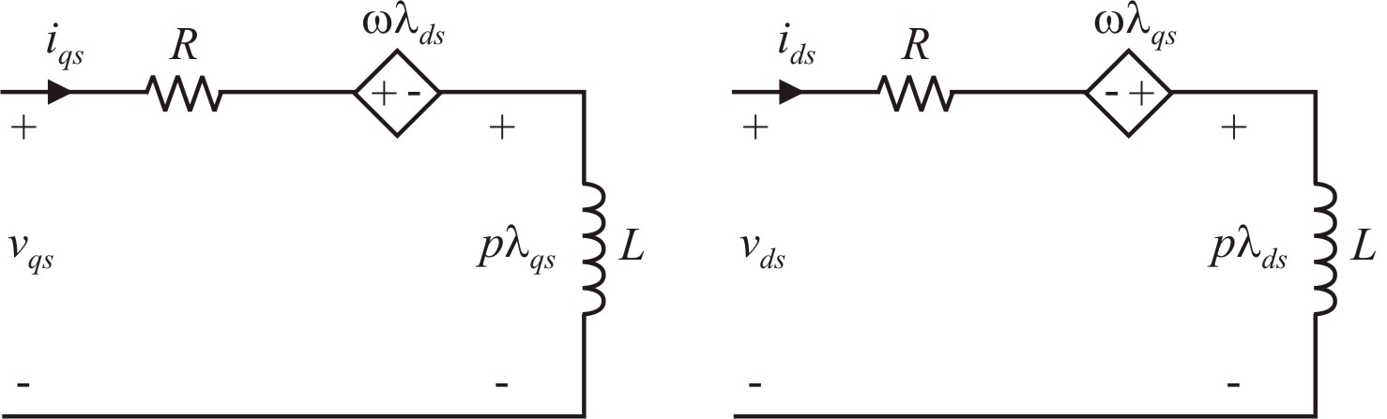
Steady-State Calculation (ω =ω_{e})
steady-state equations

Slide 34
steady-state equations in matrix form
solve for currents

Slide 35
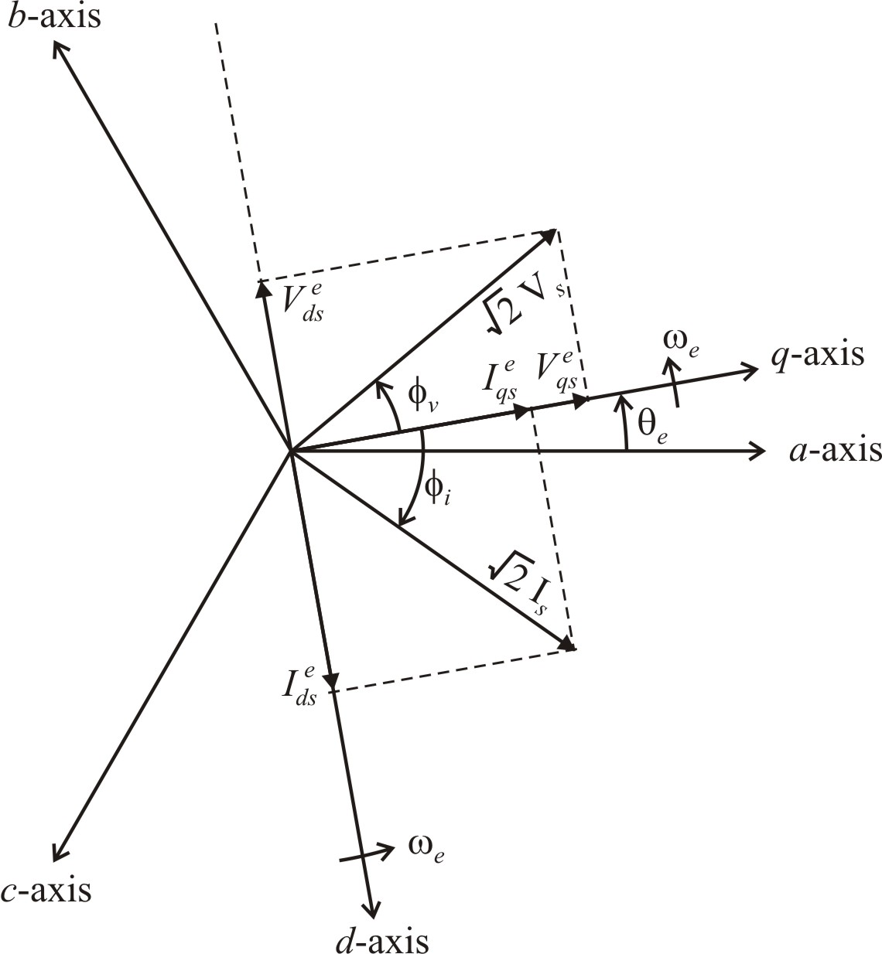
Voltage and Current Vectors

Slide 36
Steady-State q-d Calculations
In the synchronous reference frame, the q-d circuits are supplied from dc and the corresponding dc solution is steady-state (inductors treated as short-circuit, capacitors treated as open-circuit)
Can be used to analyze steady-state operation of electric machines
Equations can be linearized about the dc operating point for application of control theory

Slide 37
Active Filter Example
generator currents
Ref_ActiveFilter.psc

Slide 38
Active Filter Control

Slide 39
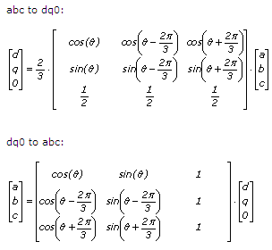
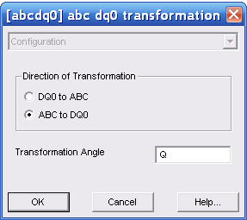
PSCAD Transformation Block
q-axis
d-axis
q- and d-axis swapped as compared to the notation in Krause's book
double-click to set reference frame angle, which may also be a variable

Slide 40
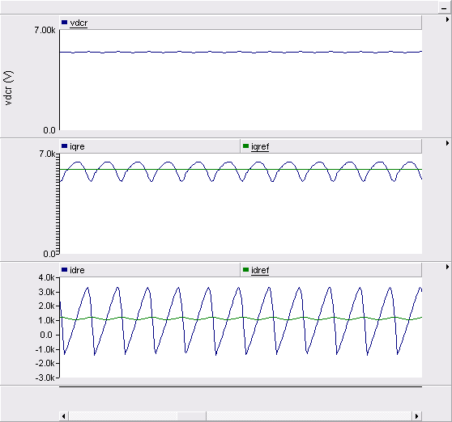
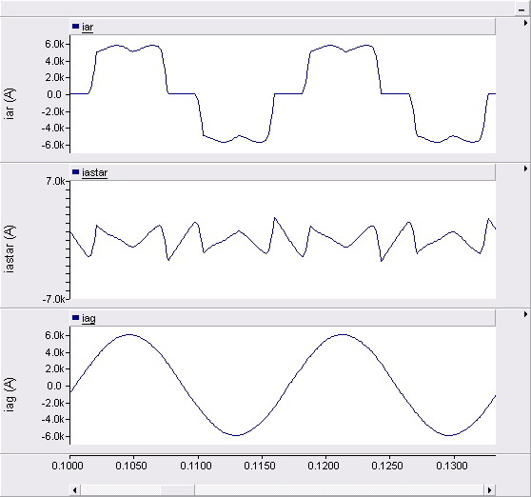
Active Filter Waveforms

Slide 41
Active Filter Example
Common in higher power applications where the main rectifier contains significant harmonics
Demonstrates an effective control method using the synchronous reference frame

